Slide 1

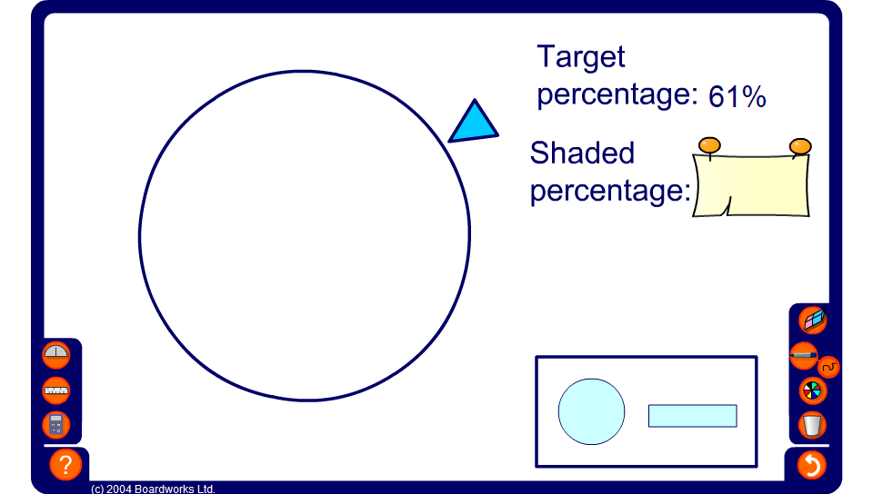


Estimating percentages
Notes:
This time ask a volunteer to use the slider to show the target percentage.

